Slide 1
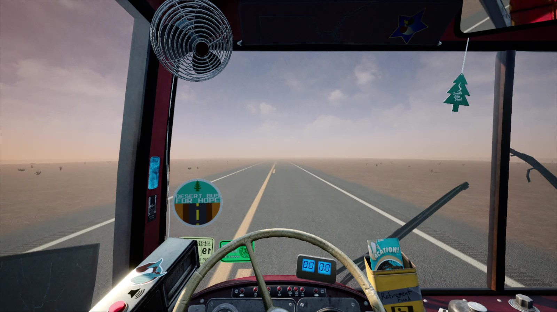
Long Road Ahead: Lessons Learned from the
(soon to be) Longest
Running Cognitive Model
Siyu Wu, Amir Bagherzadeh, Frank E. Ritter,
and Farnaz Tehranchi
(sfw5621@psu.edu , abb6024@psu.edu , frank.ritter@psu.edu , farnaz.tehranchi@psu.edu )
7/18/2023
Slides presented at ICCM 2023.

Slide 2
References (selected)
​​Schwartz, D. M., Tehranchi, F., & Ritter, F. E. (2020). Drive the bus: Extending JSegMan to drive a virtual long-range bus. In Proceedings of the 18th International Conference on Cognitive Modeling (ICCM 2020) (Vol. 241, p. 246).
Bagherzadeh, A., Tehranchi, F. (2022). Comparing Cognitive, Cognitive Instance-Based, and Reinforcement Learning Models in an Interactive Task. Accepted in Proceedings of ICCM, The 20th International Conference on Cognitive Modeling.
Ritter, F. E., Baxter, G. D., Jones, G., & Young, R. M. (2000). Supporting cognitive models as users. ACM Transactions on Computer-Human Interaction, 7(2), 141–173. https://doi.org/10.1145/353485.353486
Ritter, F. E., Tehranchi, F., & Oury, J. D. (2019). ACT-R: A cognitive architecture for modeling cognition. WIREs Cognitive Science, 10(3), e1488. https://doi.org/10.1002/wcs.1488
Newell, A. (1994). Unified Theories of Cognition. Harvard University Press.
Notes:
Adress Act_ R version

Slide 3
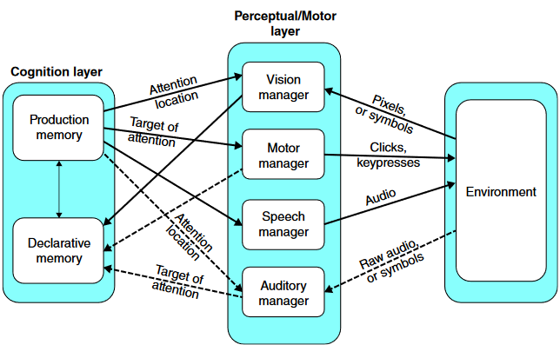
ACT-R
Image adapted from: Ritter, F. E., Tehranchi, F., & Oury, J. D. (2019). ACT-R: A cognitive architecture for modeling cognition. Wiley Interdisciplinary Reviews: Cognitive Science, 10(3), Paper e1488.
http://acs.ist.psu.edu/papers/ritterTOip.pdf
Cognitive architecture
Modules to implement the fixed mechanisms of cognition
Core
Productions,
if-then rules, actionable memory
Unmodified
Chunks,
factual memory,
slot-value pairs
Modified
Notes:
Go through quickly. Using a cognitive architecture, because if we weren’t we wouldn’t be here… This figure depicts the core cognitive components of ACT-R, other modules exist. Central to the functioning of the architecture are the procedural and declarative modules (implementing procedural and declarative memory respectively). The procedural module uses productions to encode memory about actions. They can query the buffers manage by other modules and inspect chunks. The declarative module uses chunks (a collection of slot/key value pairings) to implement factual memory. The motor system depicted is ACT-R (now part of the current ACT-R standard), developed by Mike Byrne. It adds modules to manage perception (visual and auditory), motor control, and speech. Those modules can parse the screen of applications written in AGI (ACT-R GUI Interface). They provide a great mechanism for making models that use special interfaces, but are poorly equipped to working with native interfaces (“in the wild”).
For more see Anderson; Ritter, Tehranchi, & Oury. Use figs from papers frank sent. http://acs.ist.psu.edu/papers/ritterTOip.pdf
acs.ist.psu.edu/papers/ritterTO19.pdf

Slide 4
The Challenge with Previous Driving Simulation: Unmodified Interface
Table 1. Limitations of the Schwartz et al. (2020) model
Did not start the simulation
Did not drive for more than 20 min
Only did drive for short distance mm(s)
Schwartz, D. M., Tehranchi, F., & Ritter, F. E. (2020). Drive the bus: Extending JSegMan to drive a virtual long-range bus. In Proceedings of ICCM-2020-18th International Conference on Cognitive Modeling (pp. 1-6).

Slide 5
We Created an Outperformed Model
Achieved a 1200% improvement in longer driving time compared to Schwartz et al.'s (2020) bus driving model, with a maximum running time extended to 4 hours with an average running time of 1 hour
Incorporated intelligent systems with cognitive modeling techniques (ACT-R)
Extended capabilities with robotic hands and eyes using VisiTor
Utilized different declarative chunks and production rules following the ADDIE framework
Optimized the approach for creating cognitive intelligent agents

Slide 6
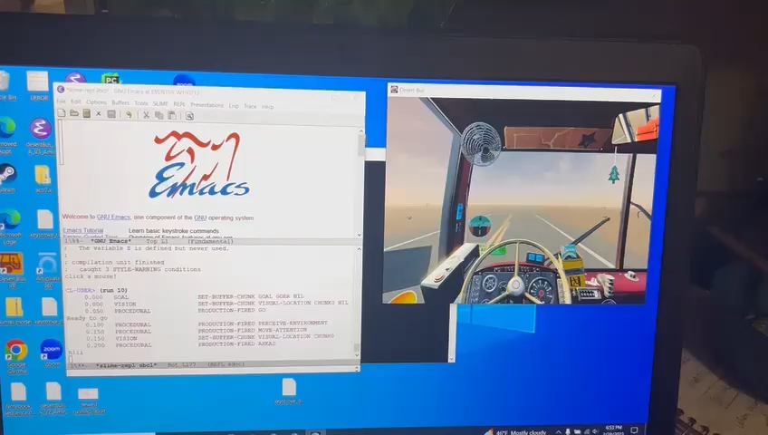
Performance Demonstration: One Loop Execution

Slide 7
We Achieve This through the Following Enhancements
Utilizes the ADDIE framework to replicate human driving behavior through declarative memories and production rules
Implements a superior control mechanism to enhance long-term bus driving performance
Enhances coordination between perceptual and motor behavior by integrating VisiTor into ACT-R 7, reducing processing time from 6.01s to 0.9s
Leverages VisiTor's extensibility to create new functions, such as the long key press function, to improve task performance.

Slide 8
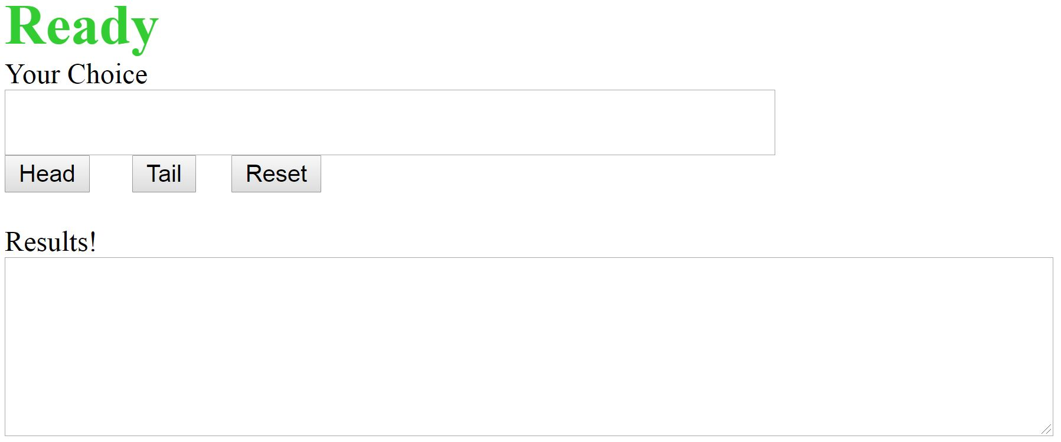
VisiTor
Bagherzadeh, A., & Tehranchi, F. (2022). Comparing cognitive, cognitive instance-based, and reinforcement learning models in an interactive task. Proceedings of ICCM, The 20th International Conference on Cognitive Modeling. 1-7.
VisiTor is a Python software package available on GitHub that provides simulated hands and eyes for computer interactions.
It offers two types of functions: motor functions and visual functions. Motor functions simulate mouse clicks, keypresses, and mouse movements to specific screen locations or visual patterns.
Visual functions in VisiTor include checking for specific visual patterns on the screen, locating patterns within defined modules, and retrieving the current mouse location.
Previous models have utilized VisiTor for interaction history, such as the "Heads and Tails" model.
Biased Coin Task
Notes:
Link to github.

Slide 9
Architecture of Interaction
The model is constructed using ACT-R 7, which incorporates a Perceptual-Motor module for accessing interfaces in Macintosh Common Lisp (MCL) and refining behavior through module modifications.
VisiTor is proposed as a solution to enable ACT-R 7 to interact with uninstrumented interfaces, providing simulated visual attention, mouse, and keyboard actions.
In the Desert Bus task context, ACT-R directs VisiTor to scan the screen for specific patterns, initiate the program, maintain the "W" key for acceleration, and perform steering actions to keep the vehicle centered on the road.
VisiTor underwent minor extensions to simplify object descriptions, incorporate various objects, and facilitate the transfer of motor commands with adjustable durations.
The addition of the "longpresskey" feature in VisiTor allows for simulating customizable key-pressing actions, enabling tasks such as continuous desert bus driving.

Slide 10
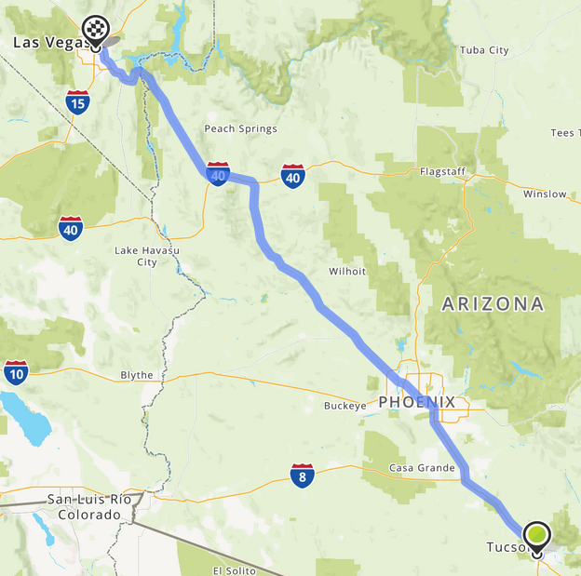
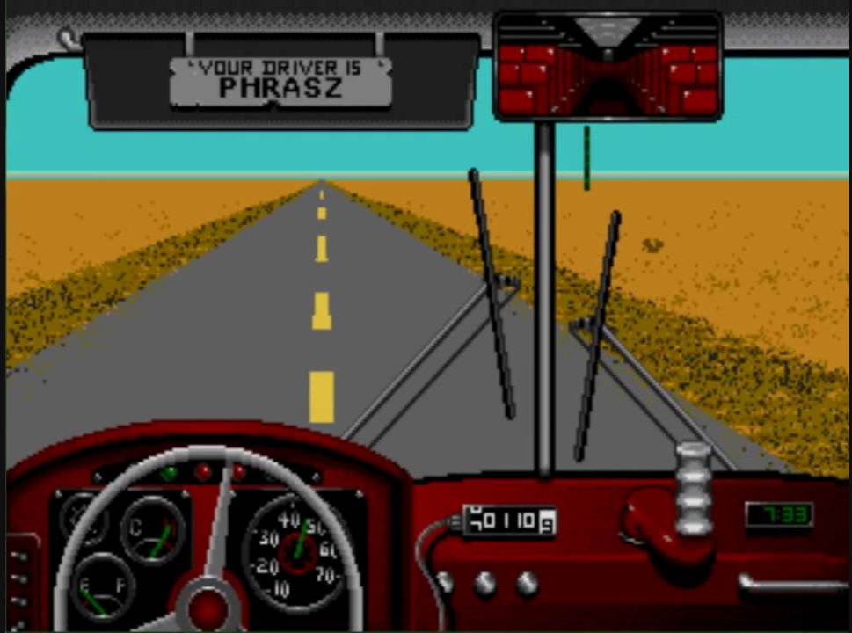
Task
Desert Bus
Drive from Tucson, AZ to Las Vegas, NV
Can go a maximum of 45 mph
”w” to go forward, “a” to go left
Game runs in real-time
  No pausing, bus pulls right and slows down
Original
Free remake by Dinosaur Games
URL here
Notes:
Game models the drive as a straight road through the desert. Takes about 8 hours to complete the journey one way. After completing it, the player is awarded one point and given the opportunity to drive back for another point. The game continues likes this endlessly. Catches: the bus veers to the right automatically. You get towed back to the start (in real-time) in Tucson if you drive off the road.

Slide 11
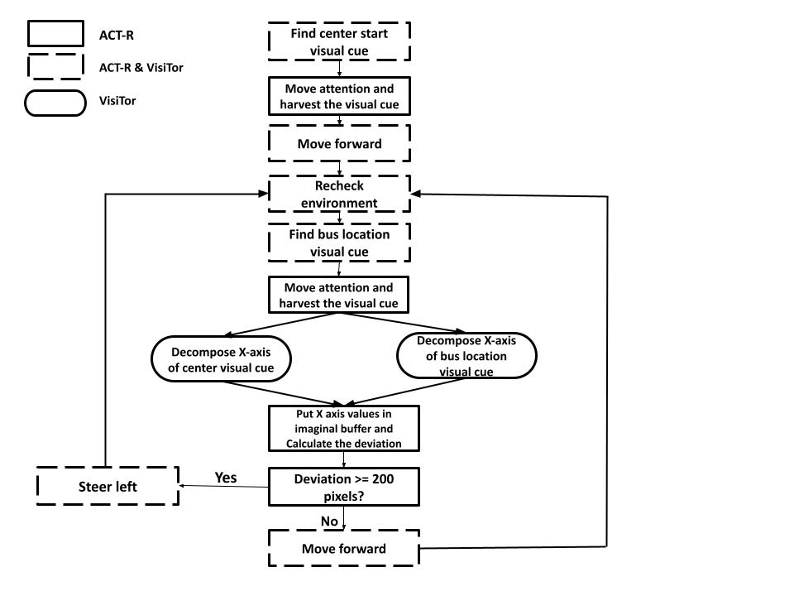
Model
The model has two types of chunks: "drive" and "encoding", with a total of 12 declarative memories.
  The "drive" chunk has slots for "strategy" and "state", with parameters for object items.
  The "encoding" chunk has slots for screen-x locations of visual cues and a deviation slot.
The model utilizes an explicit goal state to control its actions and consists of 13 production rules.
  The model investigates the simulation environment to locate and collect the necessary visual cue to initiate gameplay
  It uses the manual buffer to maintain forward motion by holding down the key.
  The model continuously evaluates the environment to gather visual cues related to the bus's location.
  It calculates the difference between the x-axis values of the center line and bus location.
  If the difference exceeds 200 pixels, the model turns the bus left by holding down the key; otherwise, it continues moving forward.

Slide 12
Highlights from the Simulation Results
Model demonstrated extended running capabilities without issues.
VisiTor's extensibility allowed for custom functions like long key presses, enhancing performance in long-term tasks, and addition of new feature in VisiTor for bus acceleration by holding "W" key.
Model outperformed previous versions, improving accuracy and driving duration.
Integration of VisiTor with ACT-R 7 improved perception-motor coordination, reducing visual template matching time.
VisiTor's extensibility allowed for custom functions like long key presses, enhancing performance in long-term tasks.

Slide 13

Discussion
(Image from the Steam page for Desert Bus VR)
Limitations
  The model's performance is limited by its inability to adapt to significant environ-mental changes like the game's shift from daytime to nighttime.​
Fatigue
  Model drives endlessly, but people cannot—what role does fatigue play?
Motivation
  How does a player manage trade-off of playing versus other responsibilities?

Slide 14
Acknowledgments
We thank Dan Bothell for ACT-R model assistance, Eric Shoch for support, and the Applied Cognitive Science and Human-Centered Artificial Intelligence Labs for providing research resources and environment.​

